Slide 1

Movie Recommendation
Prepared by-
Akshay Pandya (16IT061)
Madhav Modi (16IT056)

Slide 2

What is Recommendation System?
A recommendation system is a type of information filtering system which attempts to predict the preferences of a user, and make suggests based on these preferences

Slide 3
There are a wide variety of applications for recommendation systems. These have become increasingly popular over the last few years and are now utilized in most online platforms that we use. The content of such platforms varies from movies, music, books and videos, to friends and stories on social media platforms, to products on e-commerce websites, to people on professional and dating websites, to search results returned on Google.
Systems for recommending items (e.g. books,movies, CD’s, web pages, newsgroup messages) to users based on examples of their preferences.
Many websites provide recommendations (e.g.Amazon, NetFlix, Pandora).
There are two basic approaches to recommending:
1.) Collaborative Filtering (or social filtering)
2.) Content-based

Slide 4
Collaborative Filtering
Collaborative Filtering techniques make recommendations for a user based on ratings and preferences data of many users.
For a given user, find other similar users whose ratings strongly correlate with the current user.
The main underlying idea is that if two users have both liked certain common items, then the items that one user has liked that the other user has not yet tried can be recommended to him.
We see collaborative filtering techniques in action on various Internet platforms such as Amazon.com, Netflix, Facebook. We are recommended items based on the ratings and purchase data that these platforms collect from their user base.

Slide 5
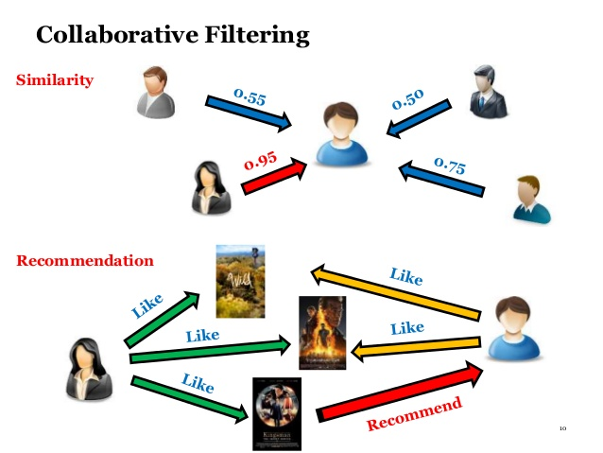

Slide 6
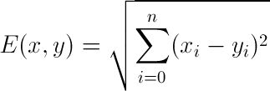
Euclidean distance
Euclidean distance is used to find similarity between two people .
The similarity measure is the measure of how much alike two data objects are.
If this distance is small, it will be the high degree of similarity where large distance will be the low degree of similarity.

Slide 7
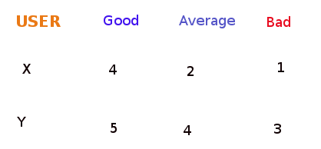

Slide 8
Pearson Correlation:
The correlation coefficient is a measure of how well two sets of data fit on a straight line. The formula for this is more complicated that the Euclidean distance score, but it tends to give better results in situations where the data isn’t well normalized like our present data set.
Implementation for the Pearson correlation score first finds the items rated by both users. It then calculates the sums and the sum of the squares of the ratings for the both users and calculates the sum of the products of their ratings.

Slide 9
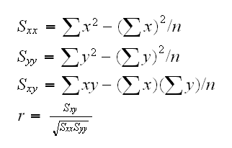

Slide 10
References
www.analyticsvidhya.com
www.datacamp.com
www.pythonforbeginners.com
Collective Intelligence book
www.udemy.com

Slide 11
Thank you…

